Slide 1

Unit-01 Introduction to the UI and UX
UI/UX Designing (UI/UX)
DU # 2301CS622
Prof. Mayur Padia
Department of Computer Science & Engineering
mayur.padia@darshan.ac.in
99255 15118

Slide 2

Looping
Outline
What is User Interface?
What is User Experience?
Importance of UI/UX Design
What do UI and UX Designers do?
Jobs in the field of UI / UX
Difference between UX and UI
Fundamental Principles of Interaction
The Design Challenge
The Seven Stages of Action
Three Levels of Processing
The Double-diamond Model of Design
Human-Centered Design Process
Personas
Empathy Mapping
Storyboarding

Slide 3

What is User Interface?
A user interface (UI) is the means through which a user interacts with a device, software, or machine.
It encompasses everything designed into an information device with which a human being may interact.
This includes screens, pages, buttons, icons, and any visual or auditory elements that enable interaction.
UI design focuses on maximizing usability and creating an intuitive, efficient, and enjoyable experience for the user.
Good UI design takes into account aspects like layout, responsiveness, accessibility, and overall aesthetics to ensure that users can easily navigate, understand, and interact with the system or product.

Slide 4
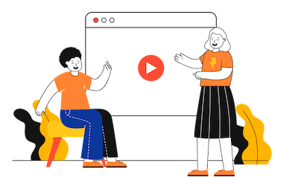
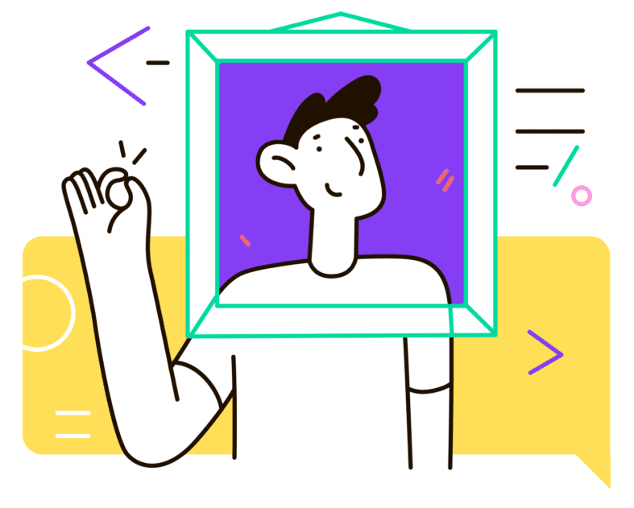
What is User Experience?
User experience (UX) refers to the overall experience a person has when interacting with a product, service, or system.
It encompasses all aspects of the user's interaction, including their perceptions, emotions, preferences, and behaviors before, during, and after using the product.
UX design aims to create meaningful and enjoyable experiences for users by focusing on understanding their needs, behaviors, and motivations.

Slide 5
UI/UX (contds.)
It involves:
User Research: Understanding the target users through methods like interviews, surveys, and observations to gather insights into their behaviors, preferences, and pain points.
Usability: Creating products that are easy to use, intuitive, and efficient. This involves designing interfaces and interactions that are user-friendly and don't require unnecessary effort to navigate.
Information Architecture: Organizing information in a clear and logical way to help users find what they need easily and quickly.
Interaction Design: Designing interactive elements and interfaces to facilitate effective communication between the user and the product.
Visual Design: Creating visually appealing interfaces that align with the brand, enhance usability, and evoke positive emotions.
Accessibility: Ensuring that the product is usable by people with diverse abilities and needs.
Feedback and Iteration: Gathering feedback from users and continuously improving the product based on their experiences and suggestions.

Slide 6

#Quote
“User experience encompasses all aspects of the end-user’s interaction with the company, its services, and its products.”
Don Norman, Cognitive Scientist & User Experience Architect

Slide 7
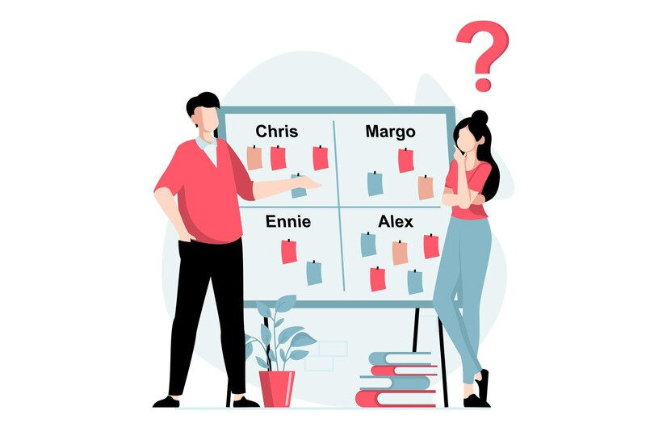



Importance of UI/UX Design
It increases customer satisfaction therefore improved ROI
Assist you to understand your audience
Raise your brand
Saves your money and time

Slide 8
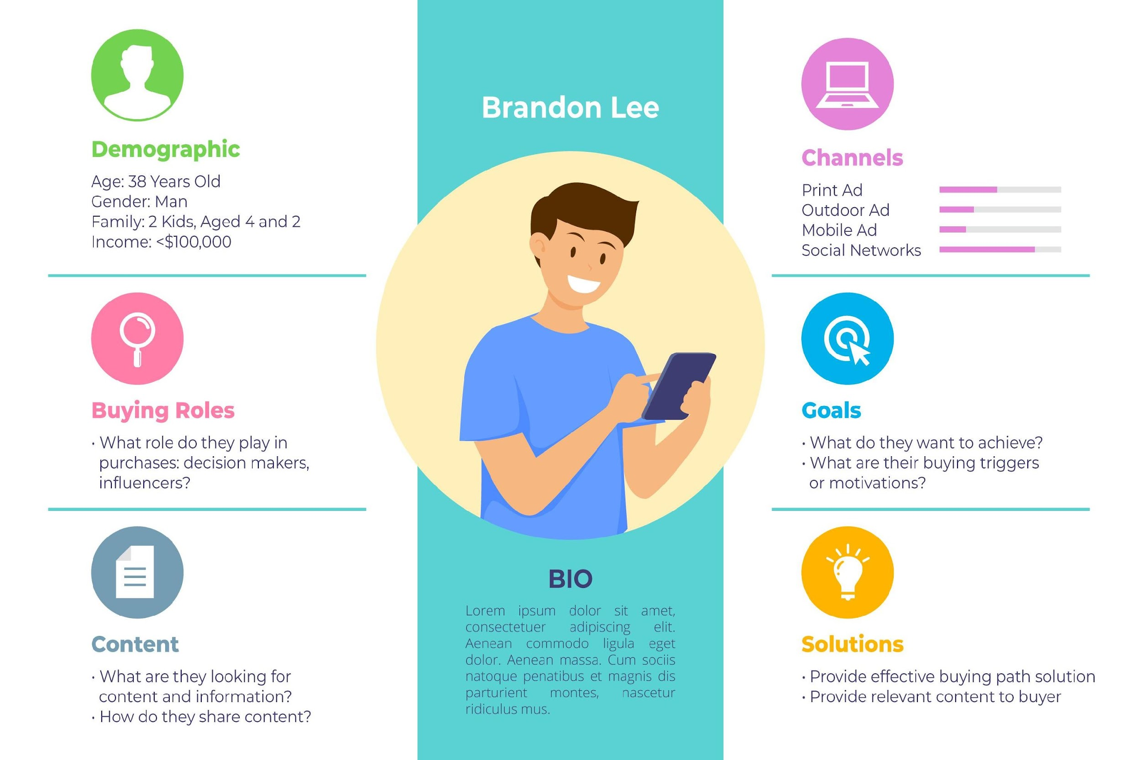

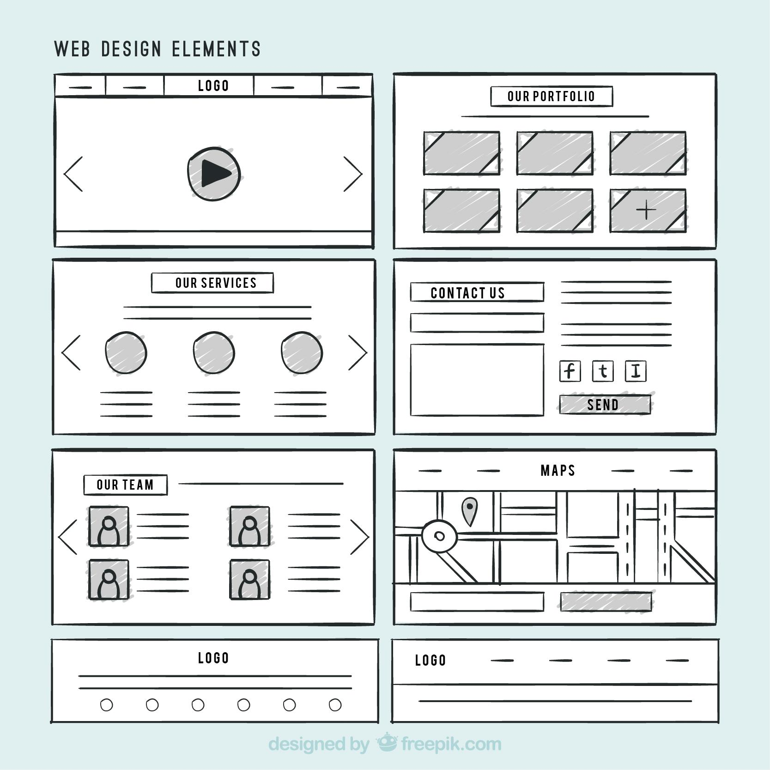

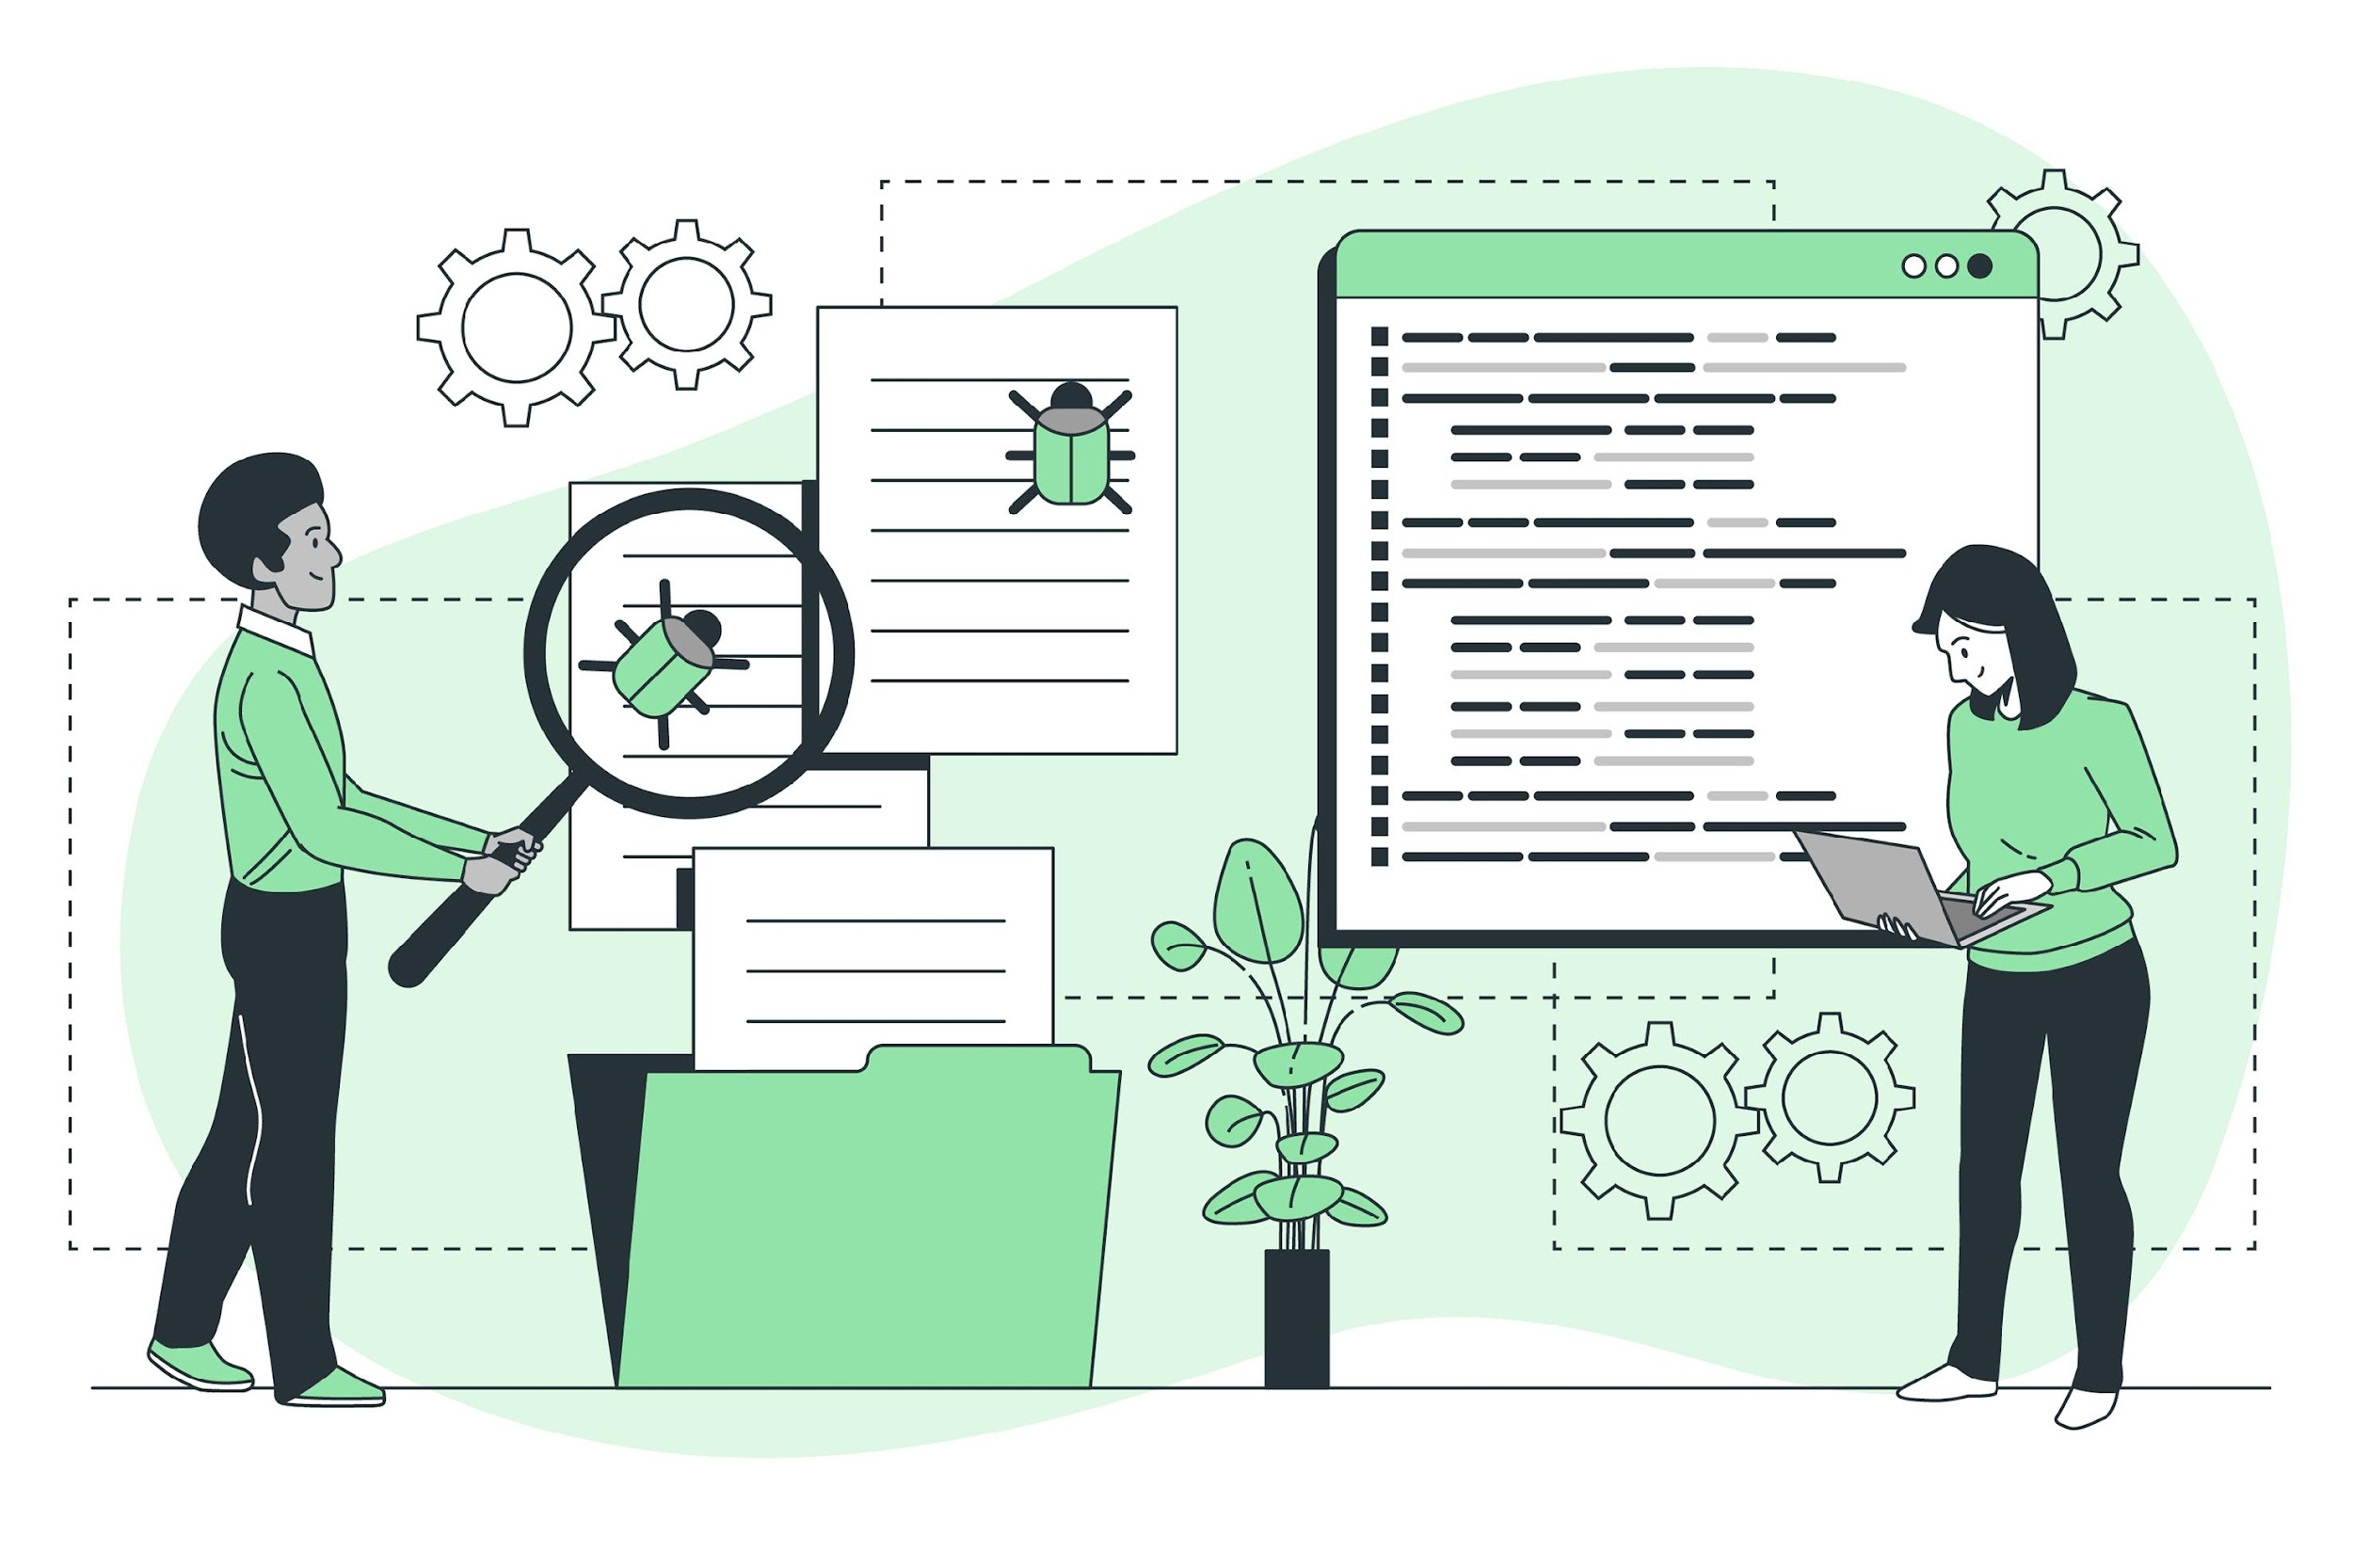
What do UI and UX Designers do?
Creates the user personas
Conducts proper user research
Designing wireframes and user flows
Making the prototypes
Conduct proper user testing

Slide 9


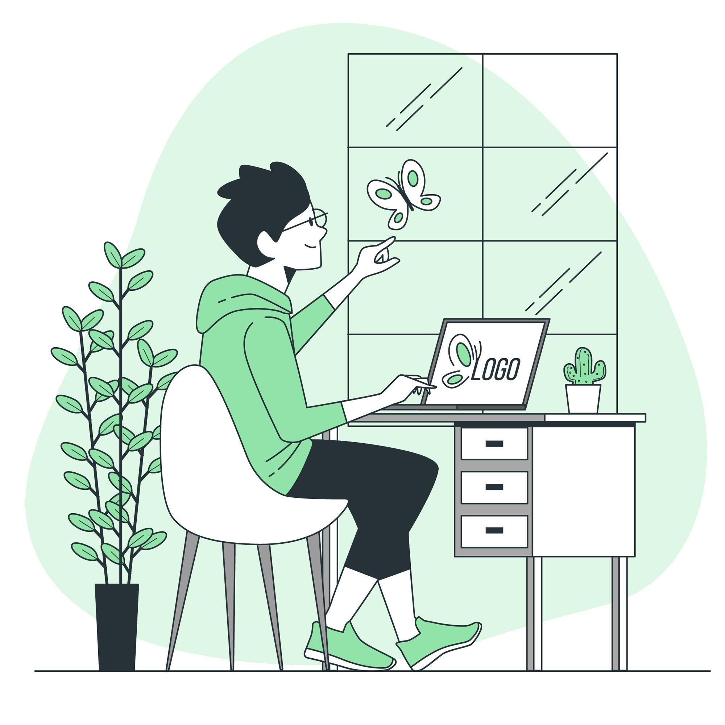
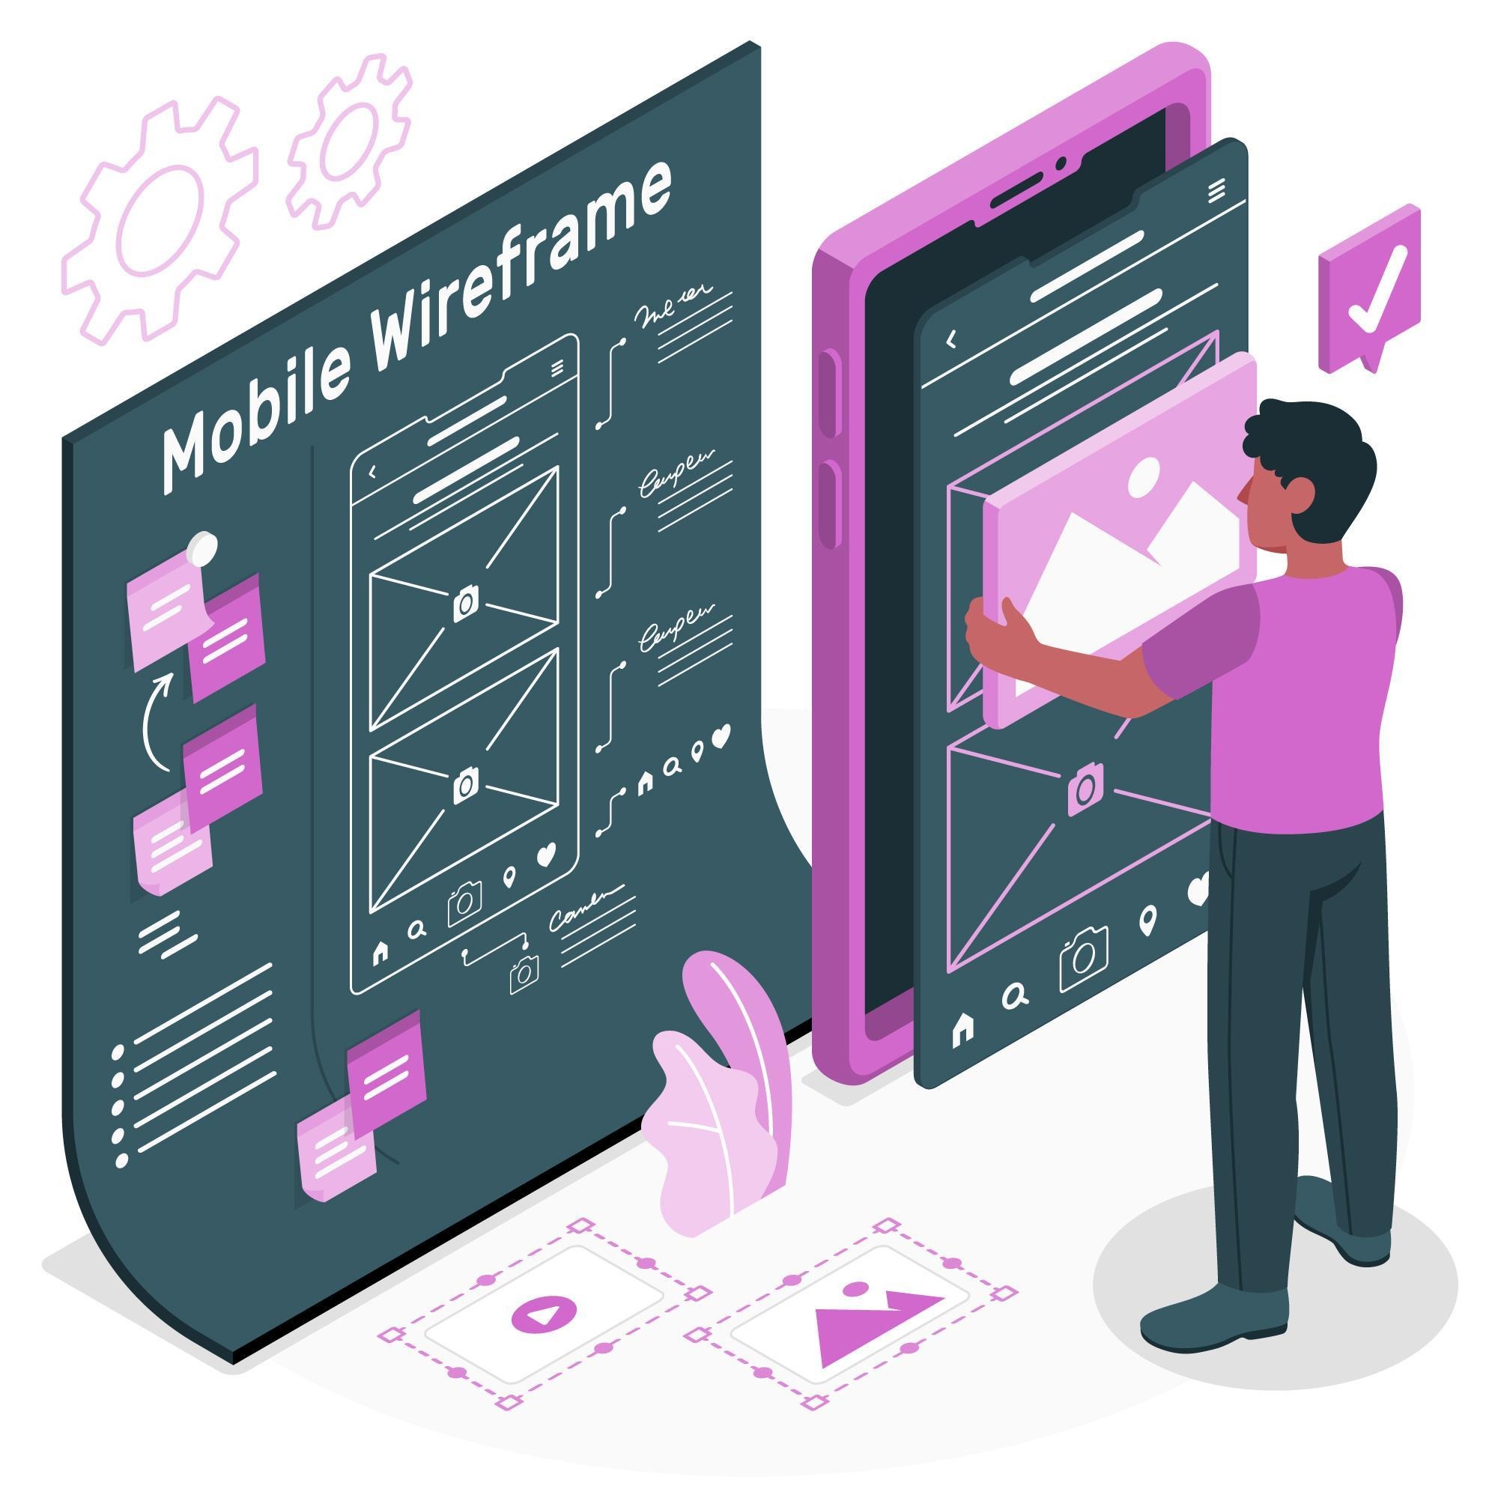



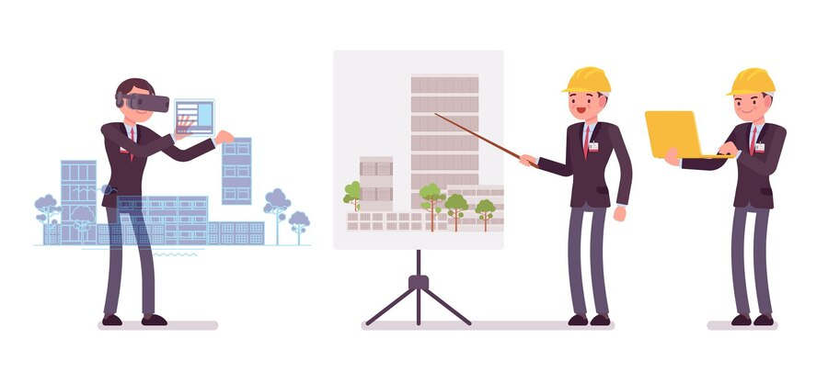
Jobs in the field of UI / UX
Interaction Designer
Visual Designer
Graphic Designer
UX Designer
UX Researcher
UX Writer
Motion Designer
AR/VR Designer
and many more..

Slide 10
Difference between UX and UI
Parameter | UX Design | UI Design
Define | Human-first approach to product design | Human-first approach to designing the aesthetic experience of a product
Application | Physical and digital products | Digital products only
Focus | The full experience from a user’s first contact to the last | Visual touchpoints that allow users to interact with a product
Creates | Structural design solutions for pain points that user encounter anywhere along their journey with a product | Combination of typography, color palettes, buttons, animations, and imagery
Results In | Products that delight users with their effectiveness | Products that delight users aesthetically

Slide 11
Fundamental Principles of Interaction
When we interact with a product, we need to figure out how to work it. This means discovering what it does, how it works, and what operations are possible.
Discoverability results from appropriate application of six fundamental psychological concepts:
Affordances
Signifiers
Constraints
Mappings
Feedback
The conceptual model

Slide 12
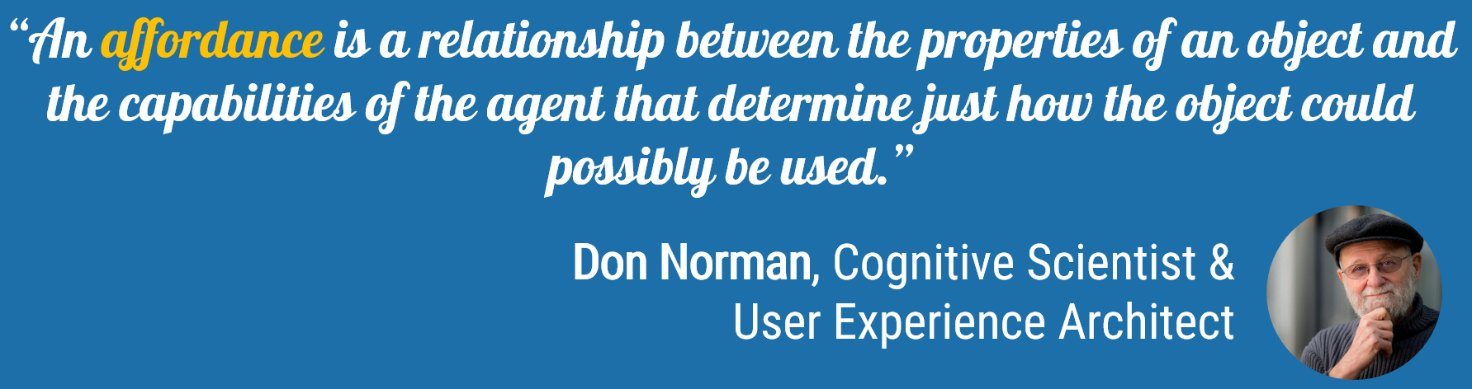
Affordances
When you want to design pleasurable and effective apps and products, you need to understand the basic interactions between humans – and the world.
You need to understand the basic interactions between humans – and the objects you design.
Essentially, that means that you need to understand what affordances are.
Affordances define what actions are possible. E.g., the ladder affords climbing for people who know how to hold their balance. The ladder would not afford climbing for a baby.
The car door (properties of the object) affords opening, if you have arms and hands (capabilities of the agent) and you know how to operate a handle (properties of the object).

Slide 13

Affordances (contd.)
Affordances represent the possibilities in the world for how the agent (a person, animal, or machine) can interact with something.
The presence of an affordance is jointly determined by the qualities of the object and the abilities of the agent that is interacting.
When you design, it’s your job to ensure that the object you design fits your target group of people.
Example: Perceiving a chair, the structure, plains and stability, we know it can be sat or stood on.

Slide 14
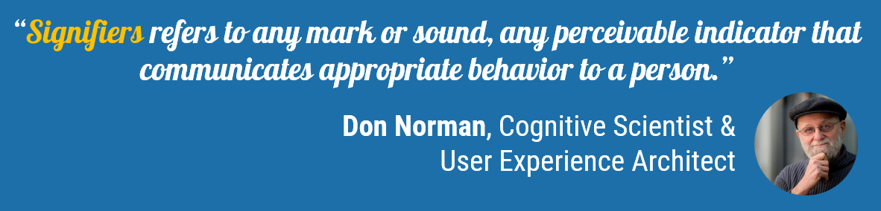
Signifiers
Signifiers are one of the most important tools of a designer.
Signifiers are signal. Some signifiers are signs, labels, and drawings placed in the world, such as the signs labeled push, pull or exit on doors, arrows and diagrams indicating what is to be acted upon or in which direction to gesture, or other instructions.
If you fail to add signifiers, people struggle to understand how they can use your product or app.
You put an unnecessary mental burden on them and you waste their precious time.

Slide 15

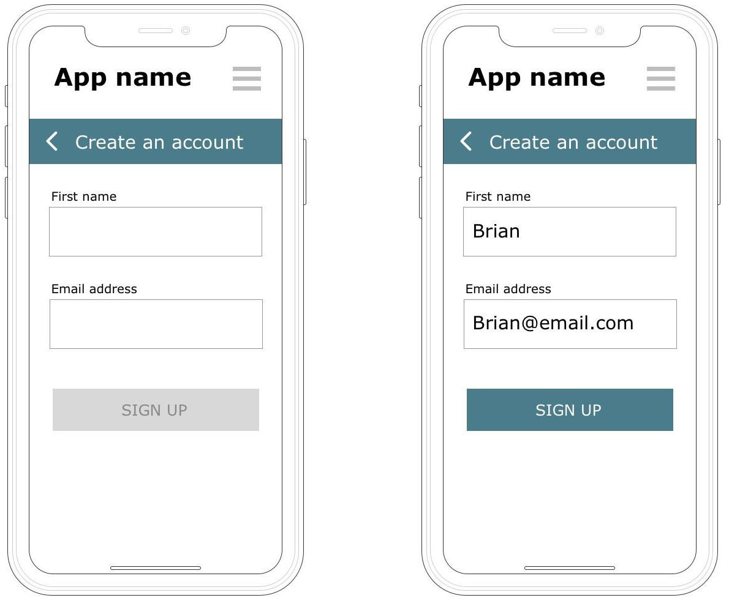
Signifiers (contd.)
People become frustrated and angry when they’re unnecessarily slowed down in achieving their goals, such as paying a bill in their bank app or buying a ticket at a metro station.
Example:
The right image signifies that the table is reserved for someone special.
The button is greyed out, suggesting it is inactive.
Looks like a button but inactive or disabled

Slide 16
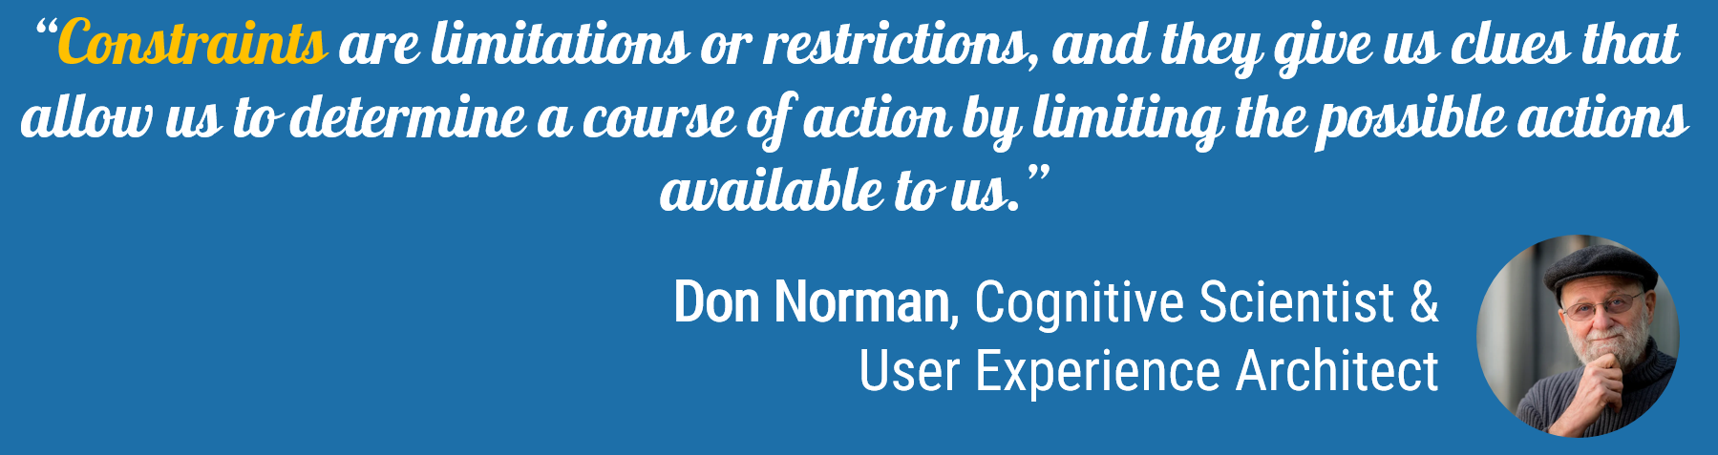
Constraints
Constraints are powerful clues, limiting the set of possible actions.
The thoughtful use of constraints in design lets people readily determine the proper course of action, even in a novel situation.

Slide 17
Types of Constraints
There are four kinds of constraints
Physical Constraints
Cultural Constraints
Semantic Constraints
Logical Constraints

Slide 18
Physical Constraints
The value of physical constraints is that they rely upon properties of the physical world for their operation.
E.g., we can not insert SD card in place of battery in camera.
It is nothing but limitations by physical features such as size and shape.
No special training is necessary. With the proper use of physical constraints, there should be only a limited number of possible actions—or, at least, desired actions can be made obvious, usually by being especially relevant.
Physical constraints are made more effective and useful if they are easy to see and interpret, for then the set of actions is restricted before anything has been done.
Otherwise, a physical constraint prevents a wrong action from succeeding only after it has been tried.

Slide 19
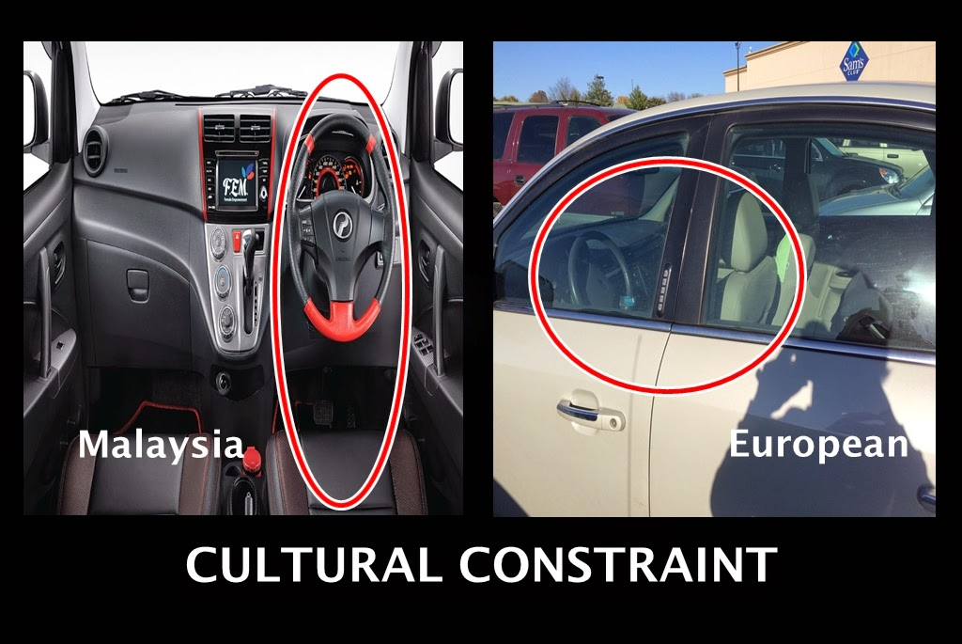
Cultural Constraints
Each culture has a set of allowable actions for social situations.
Thus, in our own culture we know how to behave in a restaurant— even one we have never been to before.
This is how we manage to cope when our host leaves us alone in a strange room, at a strange party, with strange people.
And this is why we sometimes feel frustrated, so incapable of action, when we are confronted with a restaurant or group of people from an unfamiliar culture.
Cultural issues are at the root of many of the problems we have with new machines: there are as yet no universally accepted conventions or customs for dealing with them.
For example place of steering of a car.
Cultural constraints may change with time.

Slide 20
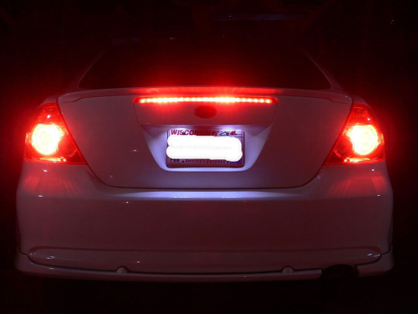
Semantic Constraints
Semantics is the study of meaning.
Semantic constraints are those that rely upon the meaning of the situation to control the set of possible actions.
For example break light in a car is meaning pull in rear side only so vehicles behind that car get signal of break.
Semantic constraints rely upon our knowledge of the situation and of the world.
Such knowledge can be a powerful and important clue.

Slide 21
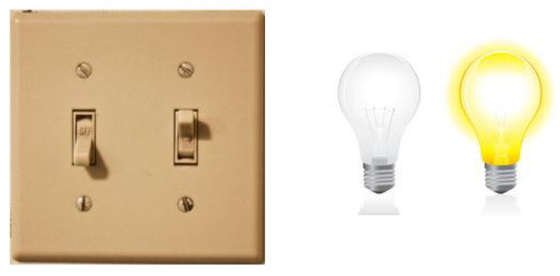
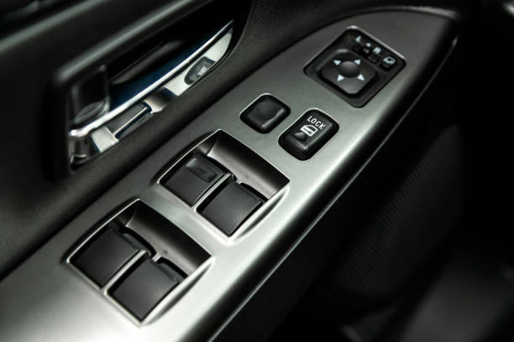
Logical Constraints
There is a logical relationship between the spatial or functional layout of components and the things that they affect or are affected by.
Logical constraints are comes to our attention because our logic is violated.
E.g., if two switches control two lights, the left switch should work the left light and the right switch, the right light.
If the orientation of the lights and the switches differ, the natural mapping is destroyed.
Similarly car window controllers are logically arranged so that we can easily get which controller controls which window.

Slide 22
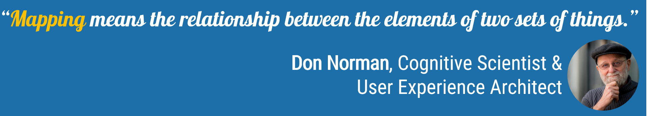
Mappings
Mapping is a technical term, borrowed from mathematics, meaning the relationship between the elements of two sets of things.
Suppose there are many lights in the ceiling of an auditorium and a row of light switches on the wall at the front of the auditorium. The mapping of switches to lights specifies which switch controls which light.
When the mapping uses spatial correspondence between the layout of the controls and the devices being controlled, it is easy to determine how to use them.
In steering a car, we rotate the steering wheel right to cause the car to turn right, the top of the wheel moves in the same direction as the car. Note that other choices could have been made but it is not good mapping.

Slide 23
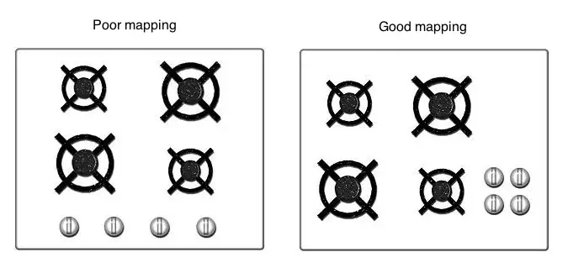
Mappings (contd.)
Mapping can be good or bad based on design so designer should keep it in a mind while designing.

Slide 24
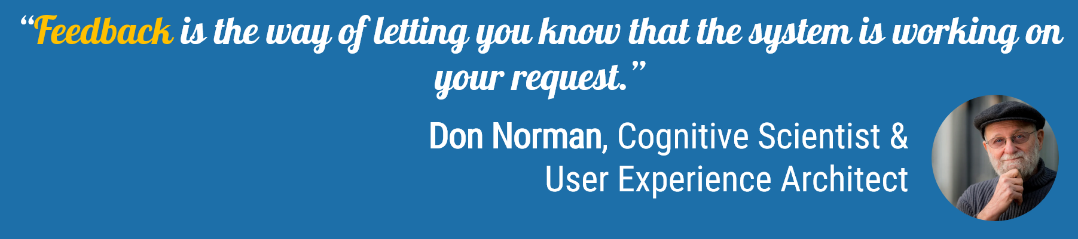
Feedback
Feedback is communicating the results of an action.
E.g., people at an elevator repeatedly push the Up/Down button if not indicated that button is pressed and lift is coming on that floor.
Characteristics of feedback are:
Communicate
Immediate
Informative
Planned

Slide 25
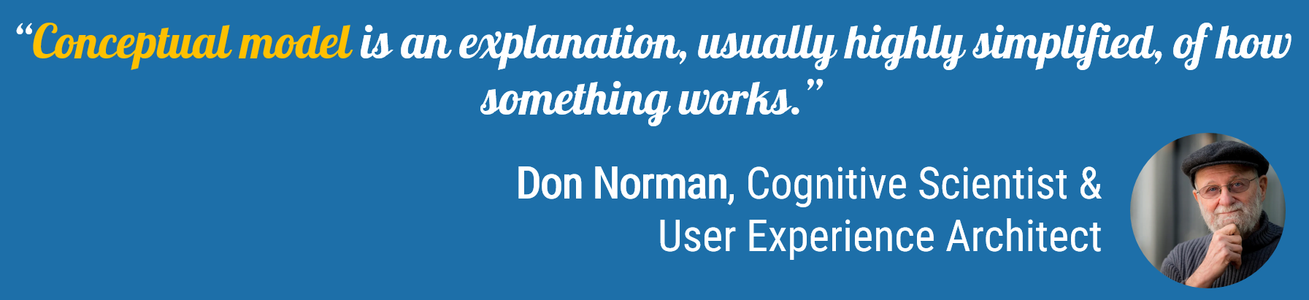
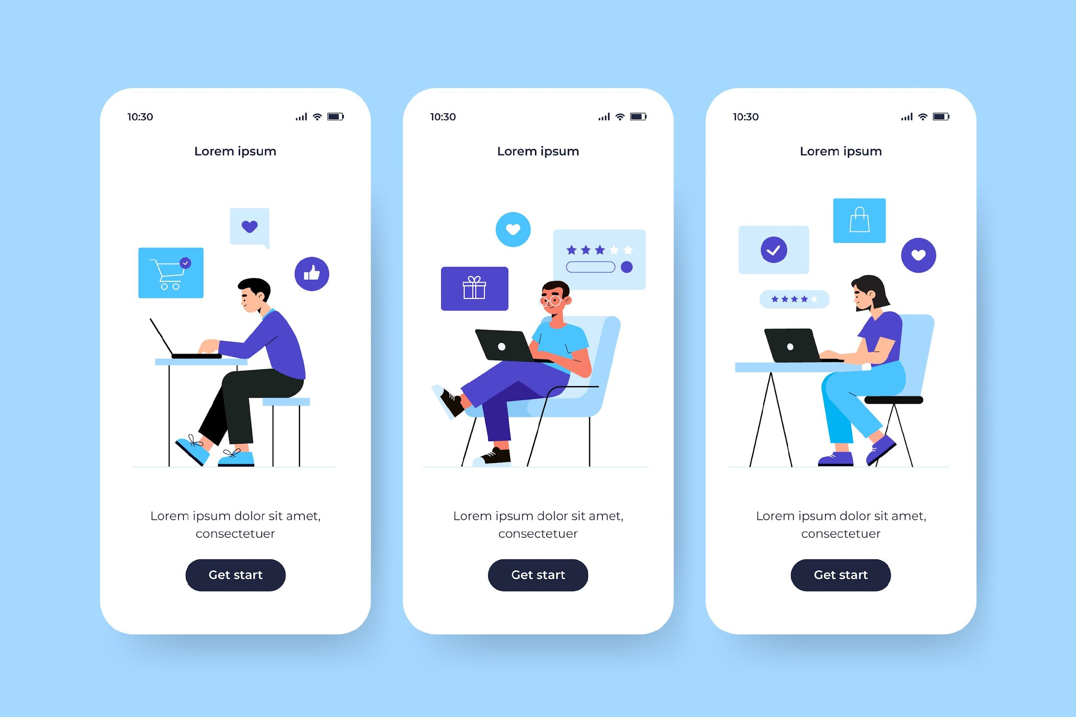
The Conceptual Model
It represent their understanding of how things work.
It doesn’t have to be complete or even accurate as long as it is useful.
Different people may hold different mental models of the same item.
Conceptual models are valuable in providing understanding, in predicting how things will behave, and in figuring out what to do when things do not go as planned.

Slide 26
The Seven Stages of Action
The "Seven Stages of Action" is a conceptual framework introduced by Donald Norman in his book "The Design of Everyday Things."
These stages outline the cognitive processes that individuals go through when interacting with a system or interface.
The framework helps designers understand user behavior and design products or interfaces that align with the user's mental model.

Slide 27
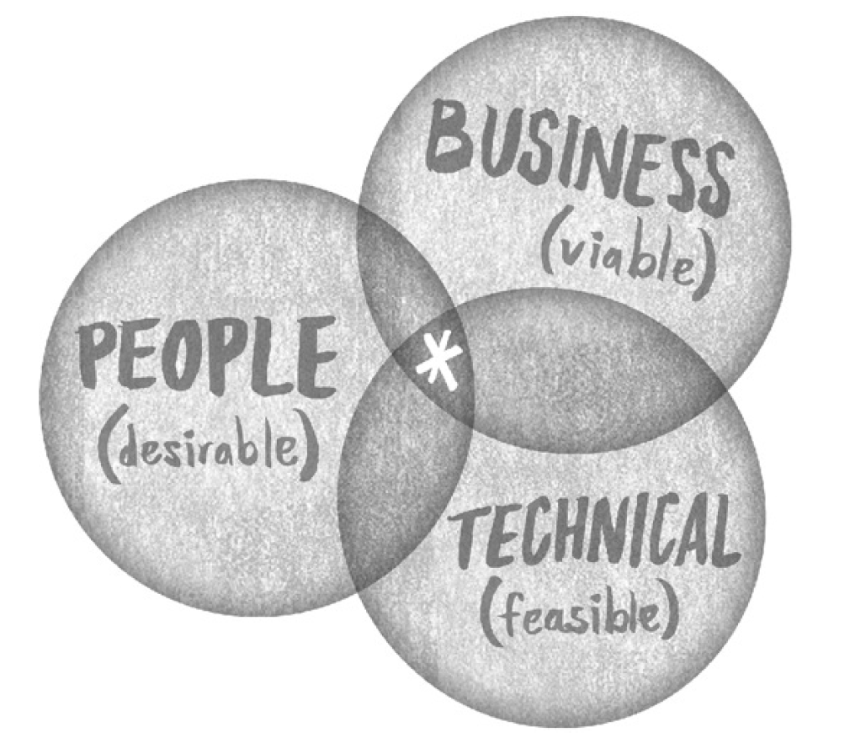
The Design Challenge

Slide 28
The Design Challenge (contd.)
Feasible (Technical Capability)
Is this idea technically achievable with current resources, time, and technology?
E.g., AI-driven personalized recommendations are feasible given Spotify's existing investment in machine learning and data analysis.
Offline listening mode is feasible with current storage and caching technologies.
Real-time lyric display is feasible if Spotify partners with lyric providers and ensures licensing agreements.
Viable (Business Value)
Does this idea align with Spotify's business goals and generate revenue?
E.g., Personalized playlists like "Discover Weekly" are viable because they increase user engagement, leading to higher retention and subscription rates.
Offering podcast integration is viable because it opens up opportunities for advertising and attracting a broader audience.
Features like premium offline mode encourage users to upgrade to a paid subscription, directly supporting Spotify's revenue model.

Slide 29
The Design Challenge (contd.)
Desirable (User-Centric Value)
Does this idea solve a real user problem or add value to the user experience?
Mood-based playlists are desirable because users want an effortless way to match music with their emotions or activities (e.g., "Chill Vibes" or "Workout Tracks").
Social sharing and collaborative playlists are desirable because they enhance users' social experience, allowing them to connect through shared music.
Voice search is desirable for ease of use, especially for users in environments where typing is inconvenient.

Slide 30
The Seven Stages of Action (contd.)
The stages are as follows:
Forming the Goal:
This initial stage involves recognizing the need or forming a specific goal.
Users identify what they want to accomplish or achieve, setting the stage for action.
E.g., The user decides they want to order dinner from a nearby restaurant.
Forming the Intention (Plan):
After establishing the goal, users form an intention to act.
This intention defines the actions required to achieve the goal.
It involves planning and deciding on the steps needed to proceed.
E.g., The user decides to use the app to browse restaurants and place an order.
Specifying an Action:
Users translate their intentions into specific actions.
This stage involves selecting a particular action sequence based on the user's mental model of the system or interface.
E.g., The user identifies actions such as opening the app, selecting a restaurant, adding
items to the cart, and completing the payment.

Slide 31
The Seven Stages of Action (contd.)
Executing the Action:
The user physically performs the chosen action.
This step involves manipulating controls or interacting with the system.
E.g., The user opens the app, navigates to a restaurant’s menu, selects dishes, and proceeds to checkout.
Perceiving the System Feedback:
Once the action is executed, the user perceives the system's response or feedback.
This feedback could be visual, auditory, or solid and informs the user about the system's state or the impact of the action.
E.g., The app displays visual feedback, such as confirmation that the items have been added to the cart or the payment is successful.
Interpreting the System State:
Users interpret the feedback received from the system, assessing whether it matches their expectations.
They evaluate whether the system's response aligns with their mental model and intentions.
E.g., The user interprets the confirmation message and order tracking updates, ensuring the order is being prepared.

Slide 32
The Seven Stages of Action (contd.)
Evaluating the Outcome:
Finally, users evaluate the outcome of their actions in relation to the initial goal.
They assess whether the goal was achieved or if adjustments are necessary to reach the desired outcome.
E.g., The user evaluates whether the food was delivered as expected and if the experience met their expectations.
Designers use this framework to create interfaces or systems that facilitate a smooth and intuitive user experience.
Aligning the design with these seven stages helps reduce cognitive load, minimizes errors, and enhances user satisfaction by ensuring that the system or product supports users throughout their interaction journey.

Slide 33

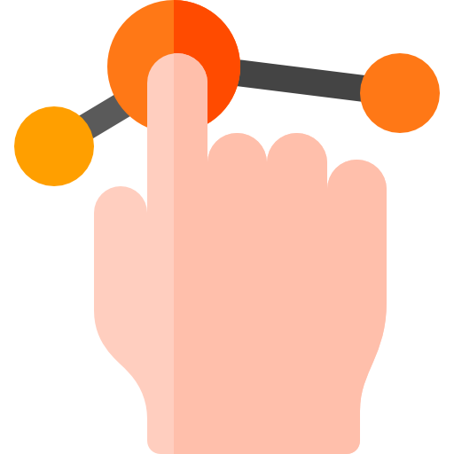
Three Levels of Processing
The "Three Levels of Processing" framework in the context of designing refers to a different concept compared to the cognitive psychology concept mentioned earlier.
In the design context, the three levels are:
Visceral Level:
This level involves the initial, immediate reaction or impression that a design evokes.
It's associated with the aesthetic appeal, sensory response, and emotional reaction to the design.
The visceral level is about the first impressions and emotional responses triggered by the appearance, colors, shapes, and sensory aspects of a design.
E.g., Dark theme with vibrant accents, Micro-interactions, Album Art
Behavioral Level:
This level is concerned with the usability, and functionality of a design.
It involves how well the design facilitates user interactions, tasks, and behaviors.
The behavioral level focuses on the practical aspects of the design, addressing questions like "How easy is it to use?" or "Does it fulfill the intended purpose effectively?“
E.g., Personalized playlists, Effortless playback controls, Offline Mode

Slide 34

Three Levels of Processing (contd.)
Reflective Level:
This level involves the deeper meaning, significance, and satisfaction derived from the design.
The reflective level considers the storytelling, symbolism, and cultural implications embedded in the design, and how it resonates with the user's values and beliefs.
E.g., Yearly Recap (Spotify Wrapped), Social Sharing, Brand Reputation
The designs should cater to all three levels of human processing: the immediate visceral reaction, the practical behavioral aspects, and the deeper reflective considerations.
Designers aim to create products, interfaces, or experiences that not only look good but are also functional, usable, and meaningful, connecting with users on multiple mental and emotional levels.
By addressing these three levels of processing, designers can create universal and impactful designs that appeal to users emotionally, functionally, and intellectually, thereby
enhancing user satisfaction and engagement.

Slide 35
The Seven Stages of Action and the Three Levels of Processing

Slide 36
The Double-Diamond Model of Design
Discover
Define
Develop
Deliver
CHALLENGE
Research
Design
DESIGN
Divergence
Convergence
Divergence
Convergence
Design principles
Focus on
the user
Communicate
(visually & inclusively)
Collaborate
Iterate

Slide 37
The Double-Diamond Model of Design (contd.)
The Double Diamond model is a problem-solving framework used in the field of design thinking.
It's often employed by designers and innovators to tackle complex issues and develop innovative solutions.
The model is structured around a series of divergent and convergent stages, forming two "diamonds" representing the process of exploring a problem space and then refining solutions.
The model consists of four key stages:
Discover:
The first diamond represents the initial exploration phase.
Here, the focus is on understanding and defining the problem.
It involves research, gathering information, empathizing with users, and identifying the core issues or challenges.
E.g., Conduct user interviews, analyse listening behaviour, competitive analysis

Slide 38
The Double-Diamond Model of Design (contd.)
Define:
This stage involves synthesizing the gathered information and insights from the discovery phase.
It's about defining the specific problem to be addressed, framing it in a way that is actionable and guiding the direction for ideation.
This phase requires a deep understanding of the users' needs and pain points.
E.g., create a feature that offers highly personalized, time-saving music discovery.
Develop:
The second diamond signifies the phase of generating ideas and exploring possible solutions.
It's a divergent phase where a wide range of concepts and possibilities are brainstormed, allowing for creativity and innovation.
This stage involves ideation, prototyping, and experimenting with various solutions.
E.g., features like "Discover Weekly," mood-based playlists, or AI-generated playlists based on listening history.

Slide 39
The Double-Diamond Model of Design (contd.)
Deliver:
The final stage involves converging on the most viable solution or set of solutions.
It focuses on refining and testing the ideas generated in the previous stage to develop a tangible prototype or plan of action.
The goal is to bring the solution to life and deliver it to the end-users or stakeholders.
E.g., launch the "Discover Weekly" playlist, auto-curated every week.
The model emphasizes the iterative nature of the design process, where each diamond represents a cycle of divergent thinking (exploration and ideation) followed by convergent thinking (decision-making and refinement).
It encourages designers to continually revisit and refine their understanding of the problem and the proposed solutions based on user feedback and insights gained throughout the process.
The Double Diamond model is highly flexible and adaptable, allowing teams to tailor it to specific contexts and challenges while emphasizing a user-centered approach
to problem-solving.

Slide 40
#Define
Human-Centered Design ( HCD )
An approach that puts human needs, capabilities, and behavior first, then design to accommodate those needs, capabilities, and ways to behaving.

Slide 41
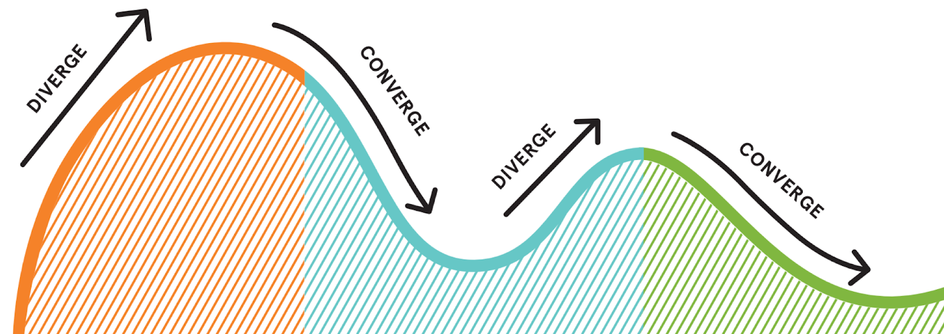
Three Phases of Human-Centered Design
DIVERGE
Here team works independently to produce individual insights. They research, analyze, generate, or design independently.
CONVERGE
Here the team discuss the results of the diverge phase as a group in order to decide on some collective output. They share their findings, insights, ideas, or design with one another.
INSPIRATION
IDEATION
IMPLEMENTATION
You’ll learn how to better understand people. You’ll observe their lives. Capture learnings.
Generate ideas. Identify opportunities for design, test, & refine. Make prototype
Bring solution to life. Get your idea to market & maximize its impact.

Slide 42
#Define
“Personas are documents that describe typical target users.”

Slide 43
Personas (contd.)
Creating personas is an essential step in the UX design process to better understand and represent your target users.
Personas are fictional characters that embody the characteristics, needs, and behaviors of a specific user segment. Here's a step-by-step guide on how to create personas:
Define Your User Segments:
Identify distinct groups within your target audience based on demographics, behaviors, and goals.
Conduct User Research:
Gather data through interviews, surveys, analytics, and any other relevant sources to understand the needs and behaviors of your users.
Identify Patterns and Themes:
Analyze the collected data to identify commonalities, patterns, and recurring themes among users.

Slide 44
Personas (contd.)
Create Persona Profiles:
For each user segment, create a persona profile that includes the following elements:
Name: Give your persona a fictional name for easy reference.
Demographics: Age, gender, location, job title, etc.
Background: Education, work experience, and relevant personal details.
Goals: What the persona wants to achieve using your product or service.
Needs and Pain Points: Identify what motivates the persona and the challenges they face.
Behaviors: Describe how the persona typically interacts with technology and your product.
Use Real Quotes:
Include real quotes from your research to add a human touch and make the personas more relatable.
Visual Representation:
Add a visual representation, such as a photo or an illustration, to make the persona more tangible.

Slide 45
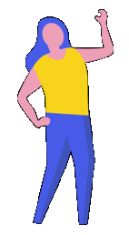
Personas (contd.)
Name: Sarah Johnson
Demographics: 32 years old, Female, Urban, Marketing Manager
Background: Holds a Bachelor's degree in Marketing, has 5 years of experience in digital marketing.
Goals: Increase brand visibility, improve lead generation, streamline marketing processes.
Needs and Pain Points: Struggles with time management, seeks tools to automate repetitive tasks, values data-driven insights.
Behaviors: Regularly uses social media for marketing research, prefers intuitive and time-saving software solutions.

Slide 46
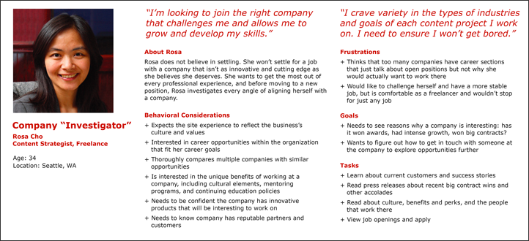
Personas (contd.)

Slide 47
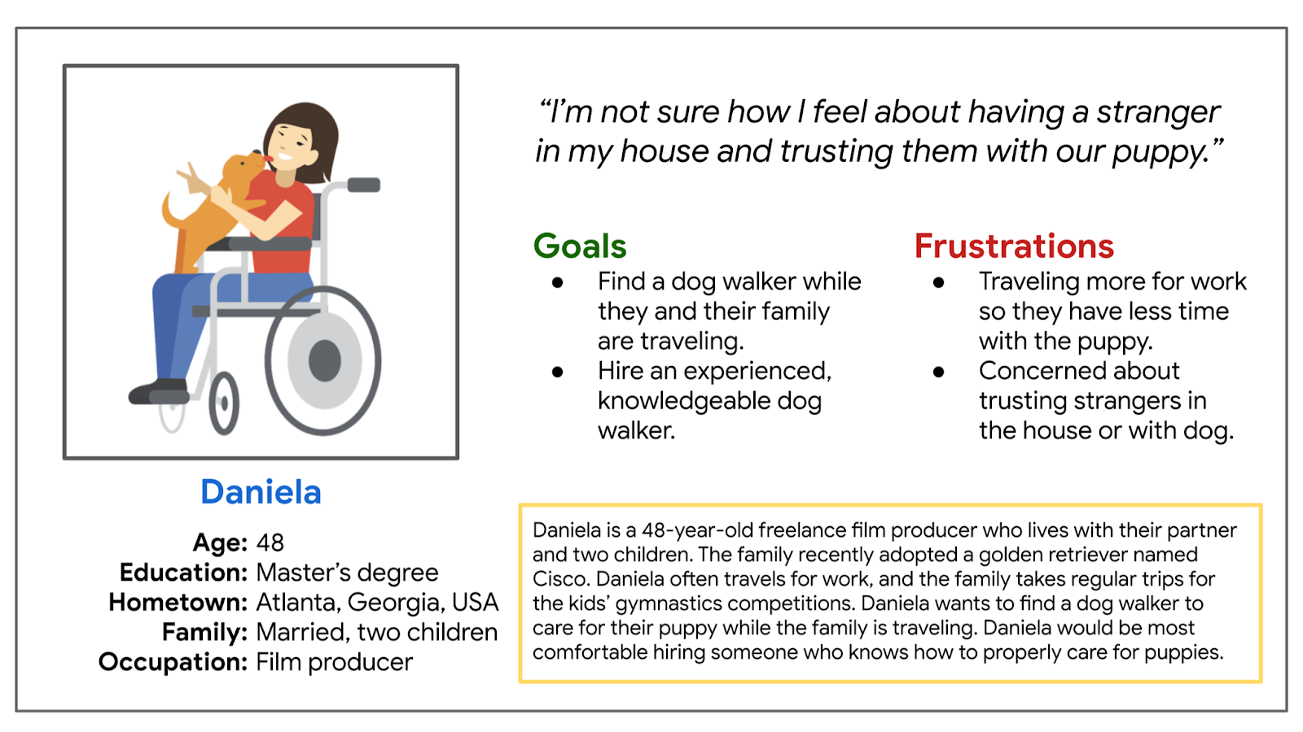
Personas (contd.)

Slide 48
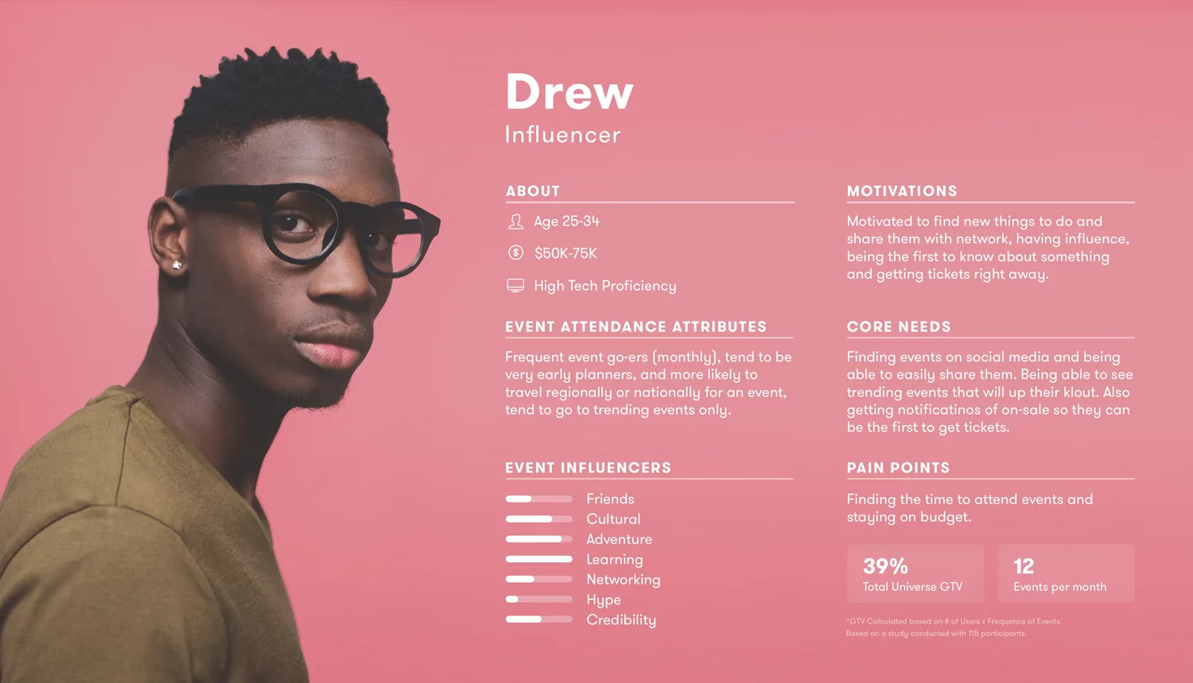
Personas (contd.)

Slide 49
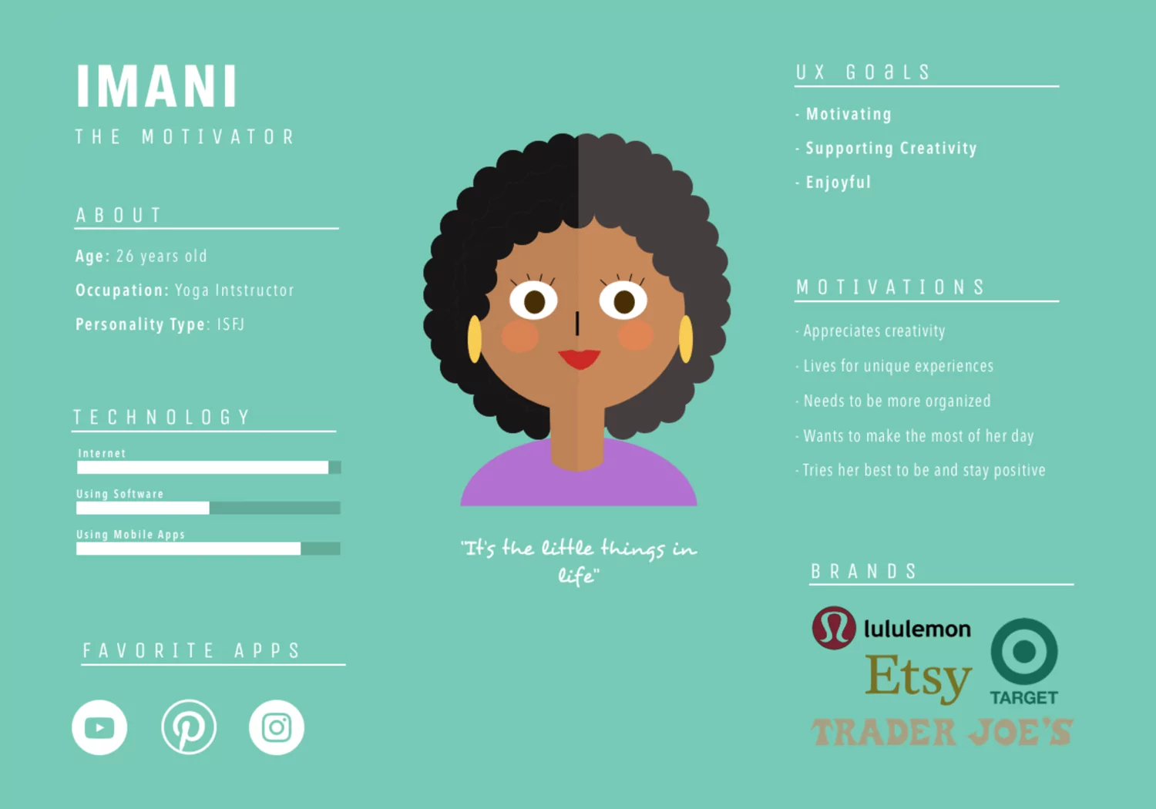
Personas (contd.)

Slide 50



#Define
Empathy
The ability to understand someone else’s feelings or thought in a situation

Slide 51
Steps to Empathy in UX
The Says quadrant contains what the user says out loud in an interview or some other usability study.
Direct quotes from research are:
I want something reliable.
I don’t understand what to do from here.
The Thinks quadrant captures what the user is thinking throughout the experience.
Ask yourself:
What occupies the user’s thought?
What matters to the user?
Quotes from research are:
This is really annoying.
Am I dumb for not understanding it?
SAYS
THINKS
User quotes
Thoughts,
motivations,
and needs
USER
Emotional
state during
the process
User behaviors
and actions
DOES
FEELS

Slide 52
Steps to Empathy in UX
SAYS
THINKS
User quotes
Thoughts,
motivations,
and needs
USER
Emotional
state during
the process
User behaviors
and actions
DOES
FEELS

Slide 53
Steps to Empathy in UX (contd.)
The Feels quadrant is the user’s emotional state.
Ask yourself:
What worries the user?
What does the user get excited about?
How does the user feel about the experience?
Key considerations:
Impatient: pages load too slowly
Confused: too many contradictory prices
The Does quadrant encloses the actions the user takes.
Ask yourself:
What does the user physically do?
How does the user go about doing it?
Key consideration from the research:
Refreshes page several times.
Shops around to compare prices.
SAYS
THINKS
User quotes
Thoughts,
motivations,
and needs
USER
Emotional
state during
the process
User behaviors
and actions
DOES
FEELS

Slide 54
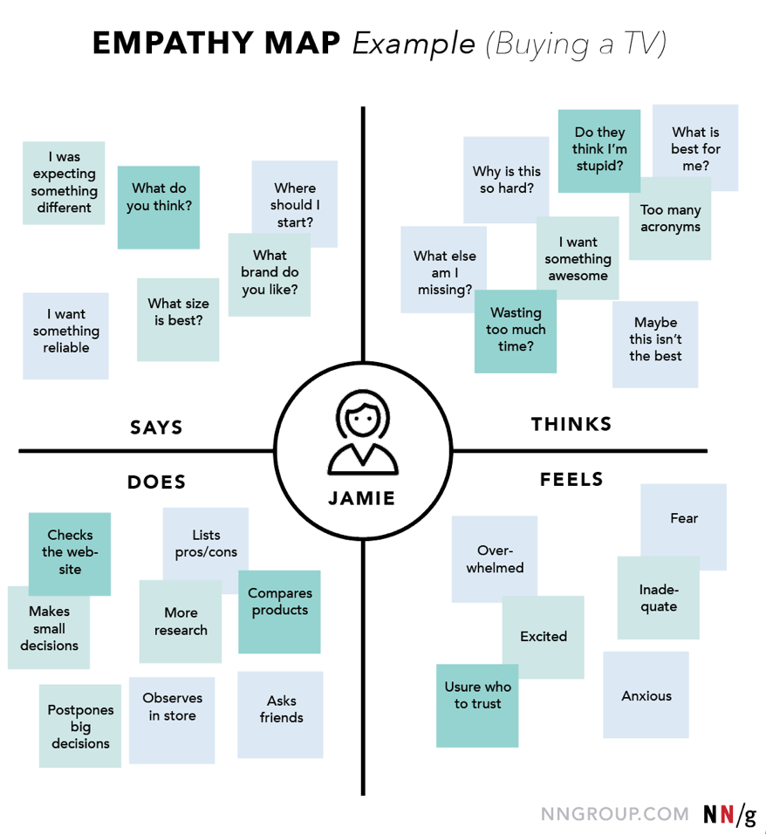
Why use Empathy Maps
Capture who a user or persona is.
Communicate a user or persona to others.

Slide 55
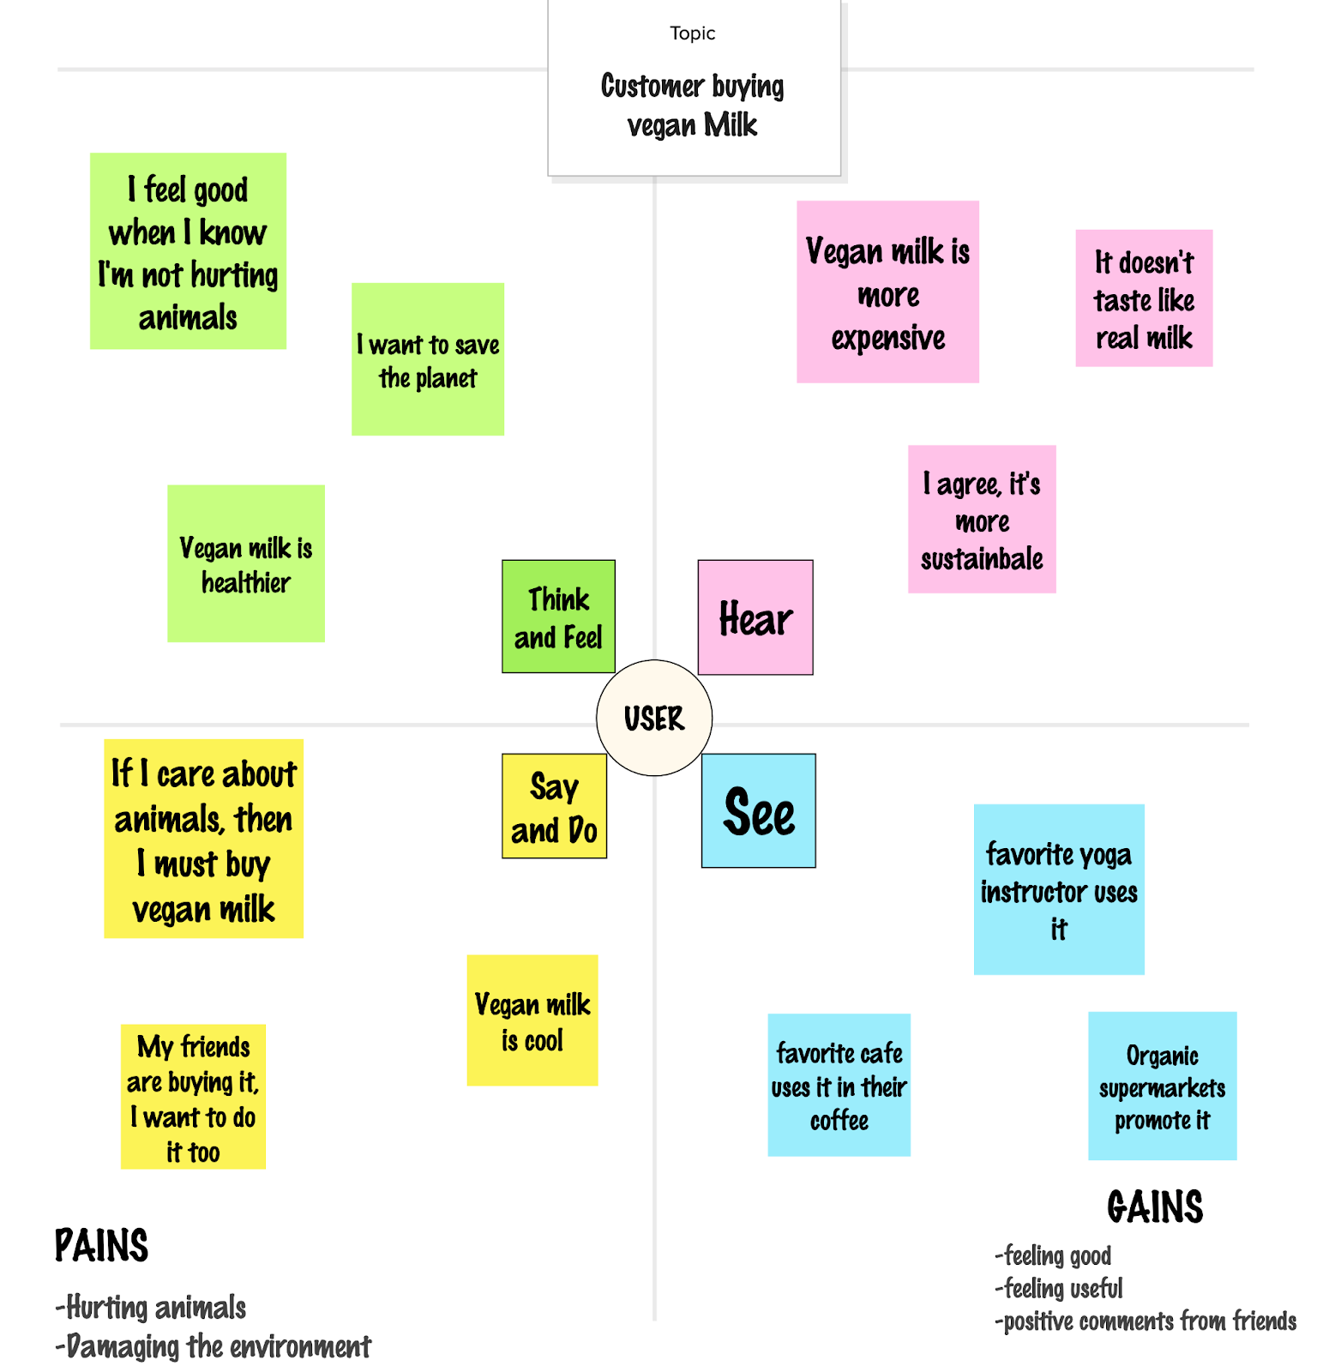

Slide 56
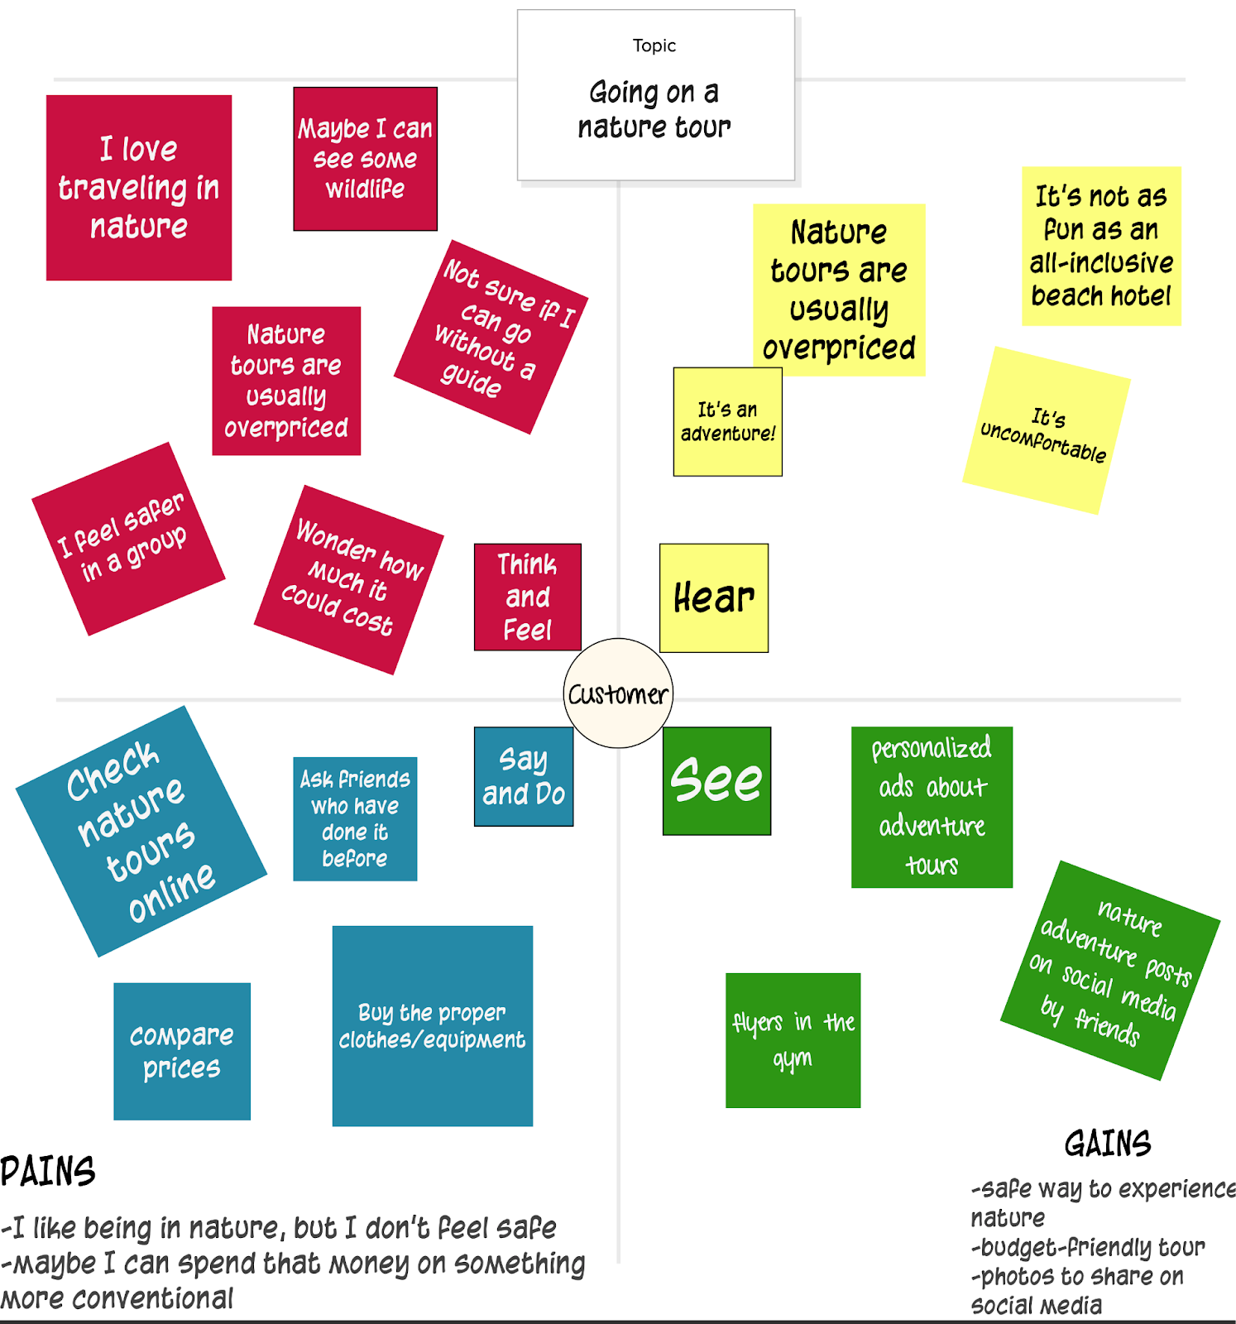

Slide 57
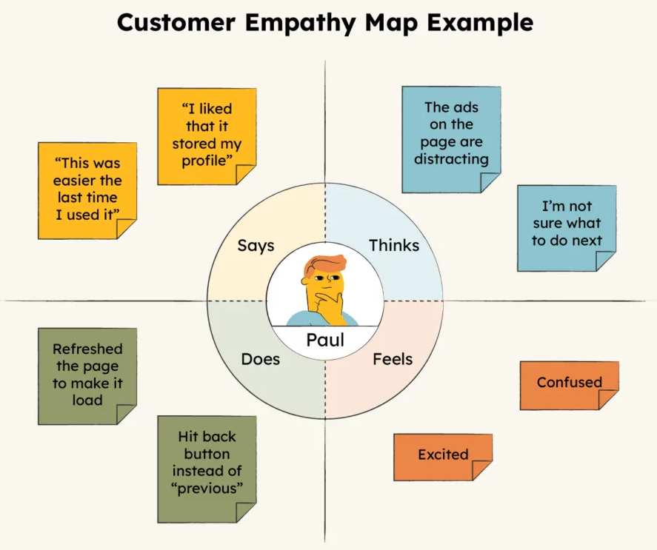
Activity Time
Prepare an empathy map of using an app
Select the app based on the ones place of your roll number:
Ones’ Place | App
0 / 5 | Flipkart / Amazon/ Myntra
1 / 6 | BookMyShow / Zomato
2 / 7 | WhatsApp / Telegram
3 / 8 | Netflix / Hotstar
4 / 9 | Instagram / Threads

Slide 58
#Define
“A storyboard communicates a story through images displayed in a sequence of panels that chronologically maps the story’s main events.”

Slide 59
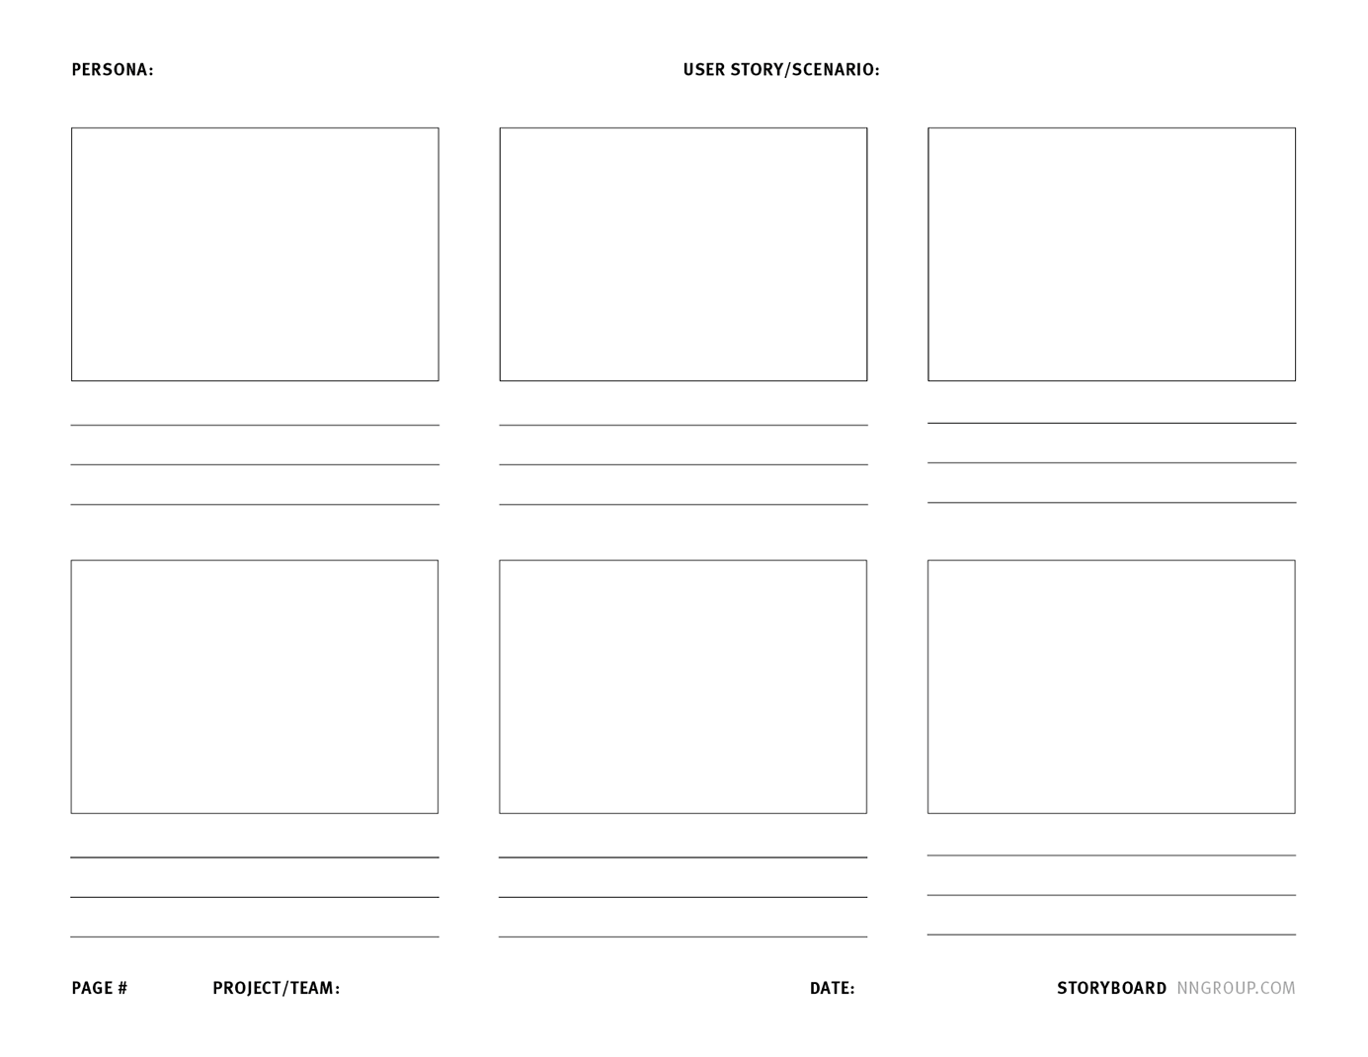
Storyboard
Storyboards provide additional background to the teams and stakeholders.
Using images makes the story quick to understand at first glance and easy to remember.
Components of Storyboard
Scenario
Visuals
Captions

Slide 60
Storyboard (contd.)
Scenario
Storyboards are based on a scenario or a user story.
The persona or role that corresponds to that scenario is clearly specified at the top of the storyboard.
A short text description of the scenario is also included.
The description of the scenario or story is clear enough that a team member or stakeholder could understand what is depicted before looking at the visuals.
E.g., Corporate buyer, James, needs to replenish office supplies.

Slide 61
Storyboard (contd.)
Visuals
Each step in the scenario is represented visually in a sequence.
The steps can be sketches, illustrations, or photos.
Images can be quick, lo-fi drawings, or hi-fi objects.
Images include details relevant to the story, such as what the user’s environment looks like, speech bubbles with quotes from the user, or a sketch of the screen that the user is interacting with.
Captions
Each visual has a corresponding caption.
The caption describes the user’s actions, environment, emotional state, and so on.
Captions are concise and don’t typically exceed two bullet points.

Slide 62
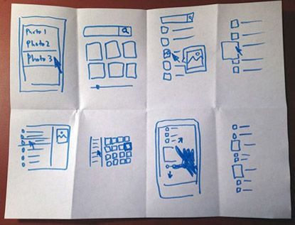
Storyboard (contd.)

Slide 63
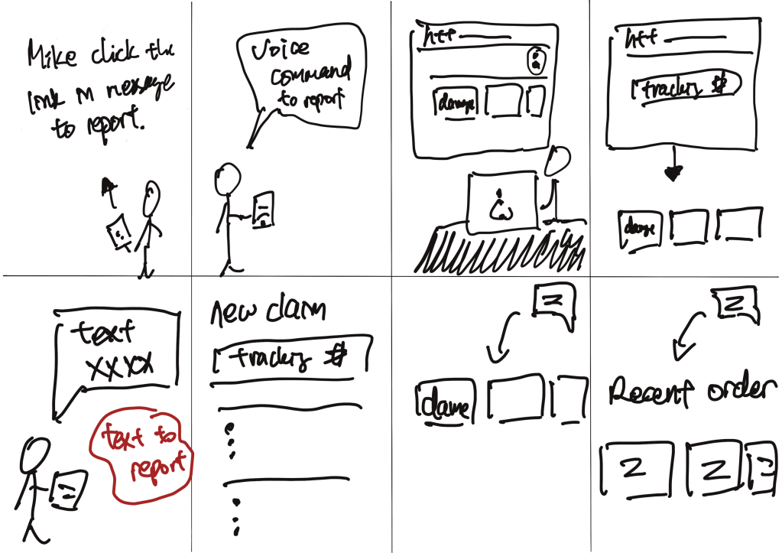
Storyboard (contd.)

Slide 64
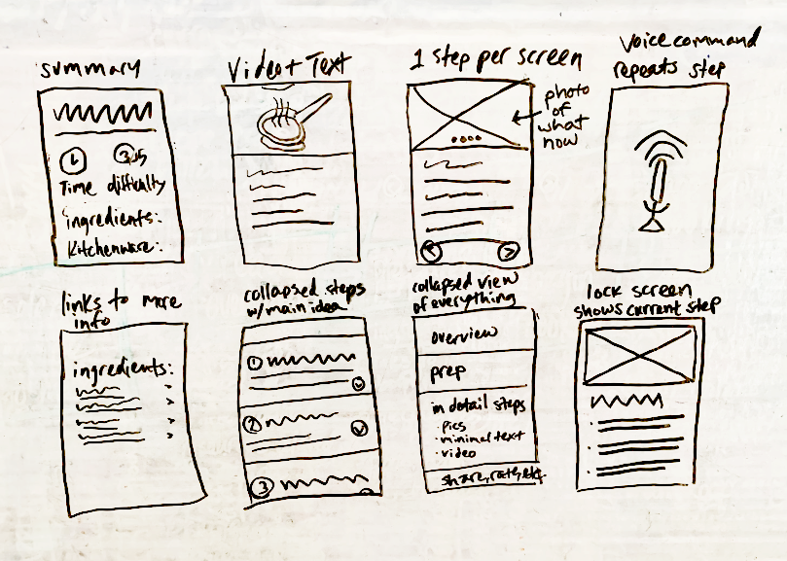
Storyboard (contd.)

Slide 65
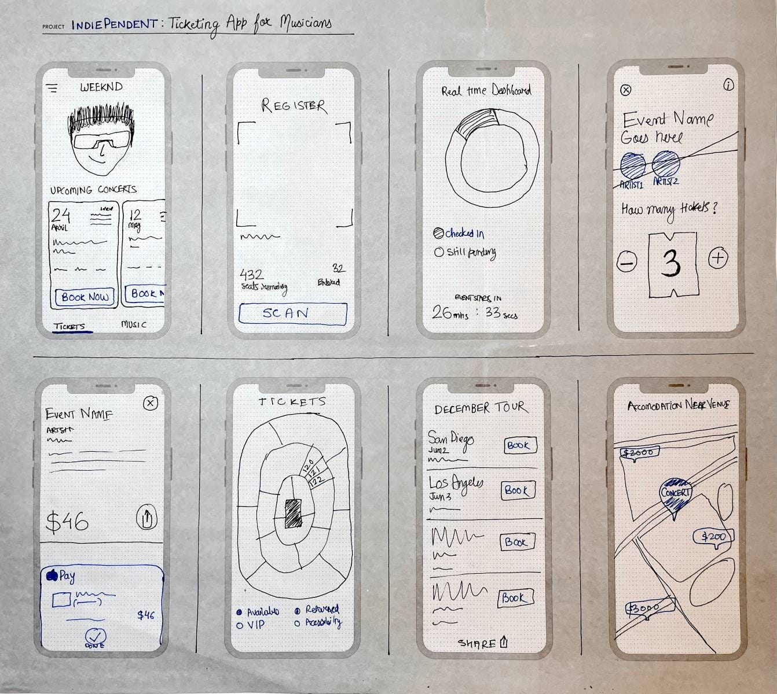
Storyboard (contd.)

Slide 66
Activity – Case Study
Draw personas, empathy map, and storyboarding for the user registering his/her complaint for lost/found items at the airport. Provide an easy way to register a complaint, and smooth process for follow-ups and recovering an item back.

Slide 67
UI/UX Designing (UI/UX)
DU # 2301CS622
Prof. Mayur Padia
Department of Computer Science & Engineering
mayur.padia@darshan.ac.in
99255 15118

